Slide 1
19AD784
IMAGE ANALYSIS AND COMPUTER VISION
Dr E Emerson Nithiyaraj
AP/ECE

Slide 2
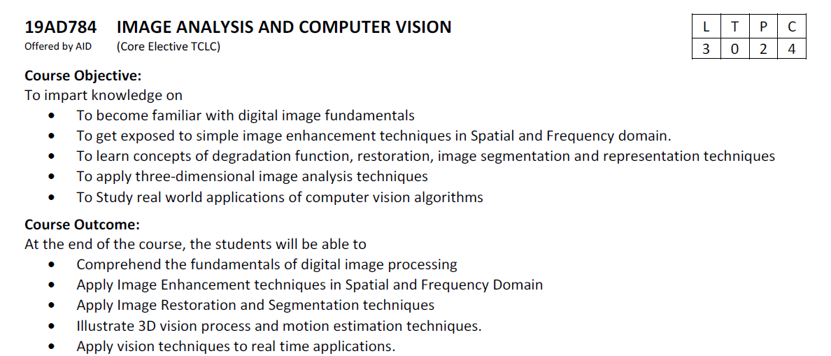

Slide 3

An Image
These small boxes are called Pixels.
Each pixel represents single point in a image.
The dimension of the image is simply the number of pixels across the image’s height(no of rows) and width(columns).
Hence the dimension of this image will be 24 x 16.
How do computers see these images ??

Slide 4
An Image
These small boxes are called Pixels.
The dimension of the image is simply the number of pixels across the image’s height(no of rows) and width(columns).
Hence the dimension of this image will be 24 x 16.
Although we see an image in this format, the computer store image in the form of numbers.

Slide 5
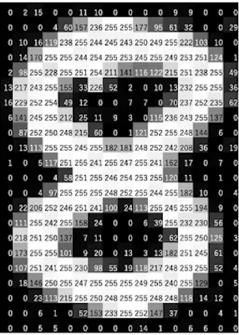
How images are stored digitally ?
Each of these pixels is denoted as a numerical value, and these numbers are called Pixel Values.
These pixel values denote the intensity of the pixels.
For a grayscale or binary image, we have pixel values ranging from 0 to 255.
Images are stored in a computer as a matrix of numbers known as pixel values.

Slide 6
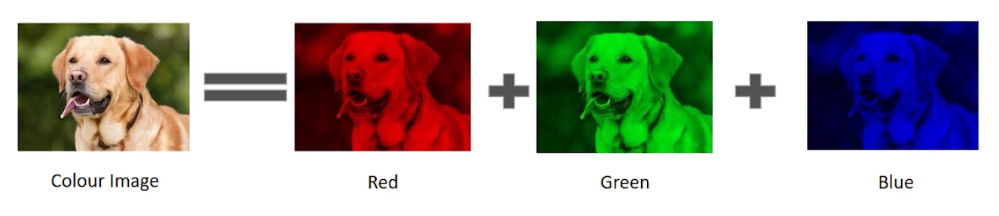
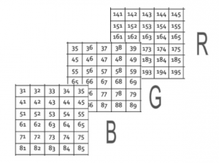

Slide 7
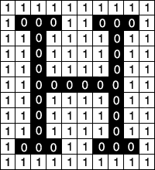
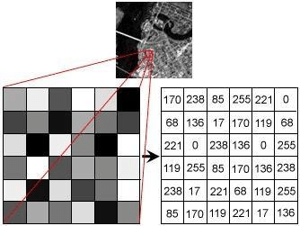
Grayscale Image (B/W image)
Binary Image

Slide 8
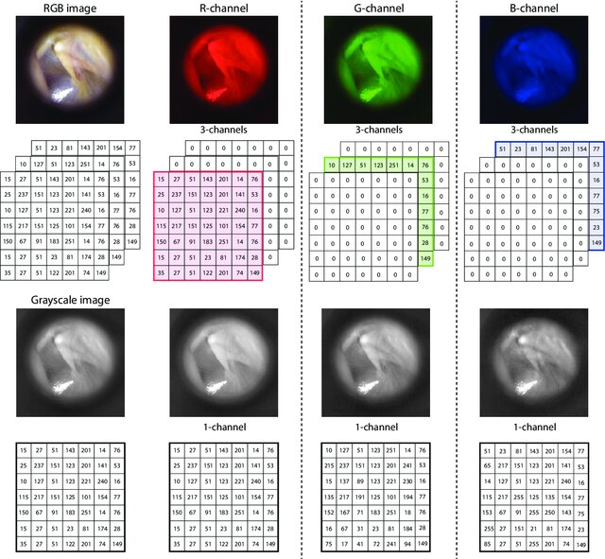

Slide 9
What is an image?
An image may be defined as a two-dimensional function, where x and y are spatial (plane) coordinates, and the amplitude of f at any pair of coordinates (x, y) is called the intensity or gray level of the image at that point.
When x, y, and the intensity values of f are all finite, discrete quantities, we call the image a digital image.

Slide 10
What is an image?
Pixel
Pixel values
Spatial Co-ordinates

Slide 11
What is an image?
A digital image is composed of a finite number of elements, each of which has a particular location and value.
These elements are called picture elements, image elements, pels, and pixels.
Pixel is the term used most widely to denote the elements of a digital image.

Slide 12
What is image analysis?
Image analysis refers to the process of extracting meaningful information from digital images using computational techniques.
It involves using algorithms and methodologies to analyze the content of images, interpret their features, and derive quantitative or qualitative data from them.

Slide 13
What is Computer Vision?
Computer vision is all about teaching computers to understand and interpret the visual world through images and videos.
It's like giving computers the ability to see and make sense of what they see, much like humans do.
This involves using algorithms and techniques to analyze digital images and videos to recognize objects, understand scenes, and even make decisions based on what they "see".

Slide 14
What is Computer Vision?
Computer vision is a field of artificial intelligence (AI) and computer science that focuses on enabling computers to interpret and understand the visual world from digital images or videos.
It aims to replicate and automate the human visual system's ability to perceive and comprehend visual information.

Slide 15
Image Analysis and Computer Vision
 | Image analysis | Computer vision
Primary Goal | to analyze the content of images, often with a focus on specific features, patterns, or measurements within the image. | to extract meaningful information from visual inputs, make sense of the environment, and take actions based on visual inputs.
Techniques | image segmentation feature extraction and pattern recognition | machine learning, and deep learning approaches
Applications | medical imaging (e.g., detecting tumors), remote sensing (e.g., analyzing satellite images for environmental monitoring) | autonomous vehicles

Slide 16
Image Analysis and Computer Vision
 | Image analysis | Computer vision
Example | Quantifying the size and shape of cells in a medical image | Recognizing faces in images, tracking objects in video streams

Slide 17
UNIT I
DIGITAL IMAGE FUNDAMENTALS

Slide 18
Digital Image Processing
The field of digital image processing refers to processing digital images by means of a digital computer.

Slide 19
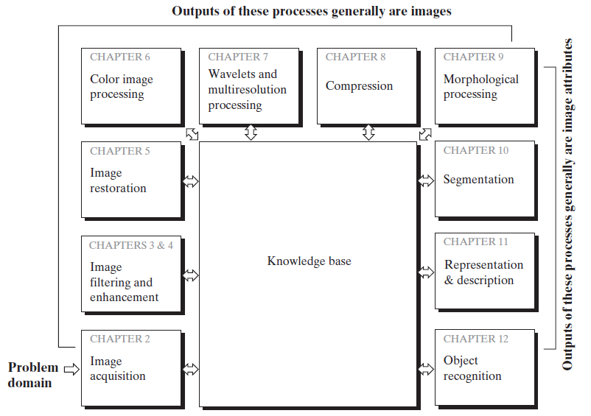
Steps in Digital Image Processing

Slide 20
Steps in Digital Image Processing
Image Enhancement: The main goal of image enhancement is to improve the visual appearance of an image to make it more appealing or useful for a specific purpose.
Image Restoration: The primary goal of image restoration is to recover the original, uncorrupted state of an image that has been degraded or damaged. This process aims to return the image as closely as possible to its original state.

Slide 21
Steps in Digital Image Processing
Wavelets are the foundation for representing images in various degrees of resolution.
Compression, as the name implies, deals with techniques for reducing the storage required to save an image, or the bandwidth required to transmit it.
Morphological processing deals with tools for extracting image components that are useful in the representation and description of shape.

Slide 22
Steps in Digital Image Processing
Knowledge about a problem domain is coded into an image processing system in the form of a knowledge database.
This knowledge may be as simple as detailing regions of an image where the information of interest is known to be located, thus limiting the search that has to be conducted in seeking that information.
The knowledge base also controls the interaction between modules.

Slide 23
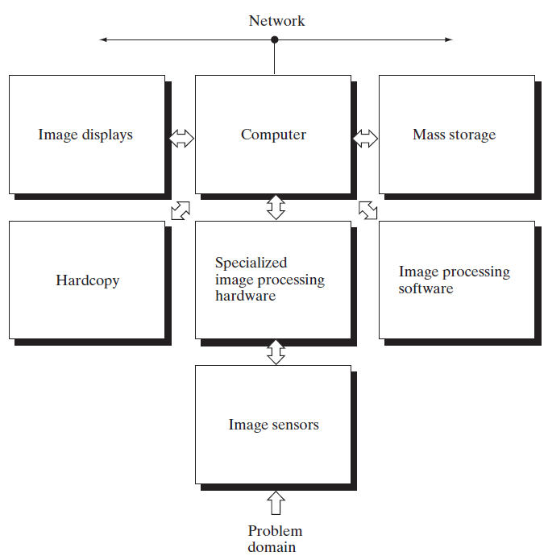
Components of an Image Processing System
Figure shows the basic components comprising a typical general-purpose system used for digital image processing.

Slide 24
Today’s Task
Analog versus Digital Images
Resolution of a 4K image.
Image resolution vs. Image dimension

Slide 25
Usually expressed in the pixels per inch (PPI) or dots per inch (DPI), image resolution describes the sharpness or clarity of a picture. Larger file sizes are side effect of the higher resolutions, which produce much clearer images. For high-quality printouts, standard print resolutions are 300 DPI or much more .
Dimensions are the total number of pixels along the width and height of an image. Resolution is the number of image pixels assigned to each inch when an image is printed - measured in pixels per inch (ppi). Thus, the more pixels an image has per inch, the greater will be its resolution.

